Slide 1



UNH SEDS
CEPS Engineering Organization
High Power Rocketry
University of New Hampshire
Students for the Exploration and Development of Space

Slide 2
https://www.youtube.com/watch?v=b7orLTpm6tk
https://www.youtube.com/watch?v=wvJ64NYke1E
University of New Hampshire
Students for the Exploration and Development of Space

Slide 3
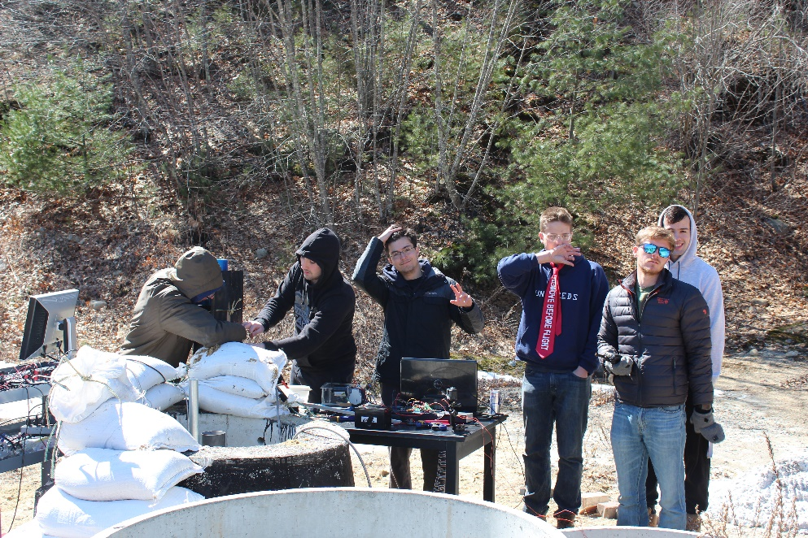
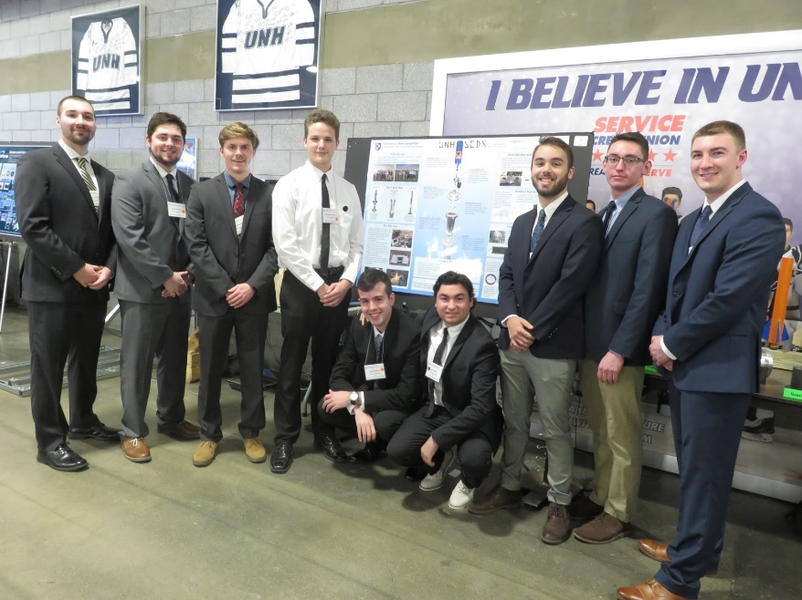
What is UNH SEDS?
UNH SEDS (Students for the Exploration and Development of Space)
Rocketry Organization
Founded 2017
Competing in Spaceport America Cup 2020 in New Mexico
University of New Hampshire
Students for the Exploration and Development of Space
Notes:
Seds is a naitionwide organization that allows colleges from around the world to start a chapter. Although we are allowed to do whatever we would like as an organization, they do sponsor competition for SEDS groups as well as national conferences, the next one for the beginning of November. We are a team comprised of many majors and all classes, so applying to join our team would not only be a senior project, but an interdisciplinary experience.

Slide 4
Senior Design
Hybrid Rocket
University of New Hampshire
Students for the Exploration and Development of Space

Slide 5







Project Overview
Students for the Exploration and Development of Space (SEDS)
Third year organization
Design and test a hybrid rocket
Applying rocket mechanics from last two years knowledge
Spaceport America Cup - June 2020 in Las Cruces, New Mexico
10,000 ft altitude student researched and developed hybrid class
Target apogee 10,000 feet
Build, test, analyze, optimize
University of New Hampshire
Students for the Exploration and Development of Space

Slide 6

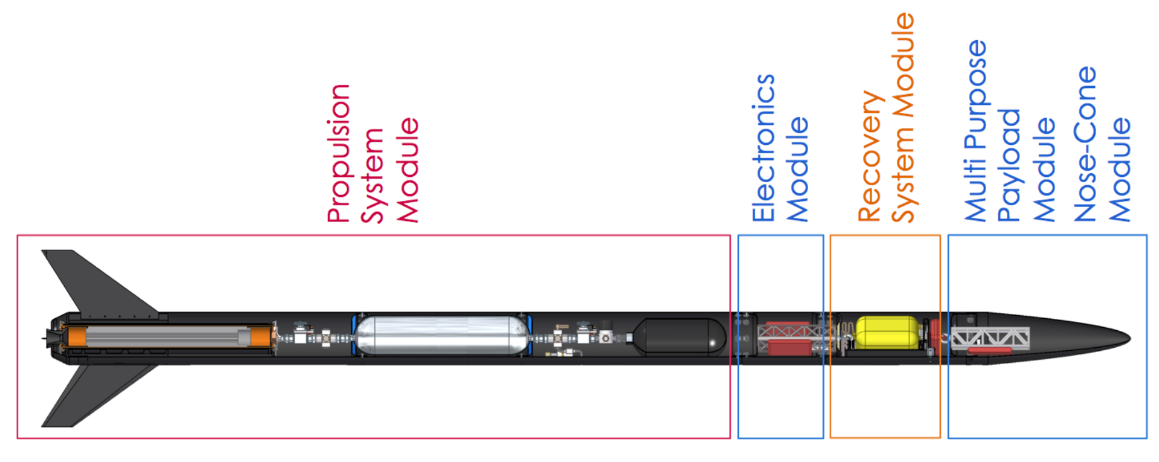
What is a Hybrid Engine Rocket?
Rocket is propelled via solid and liquid components
HTPB Rubber and Nitrous Oxide
Hydroxyl-terminated polybutadiene
Nose Cone
Parachute
Oxidizer
Injector Plate
Centering Rings
Combustion Chamber
Stabilization Fins
Nozzle
University of New Hampshire
Students for the Exploration and Development of Space

Slide 7
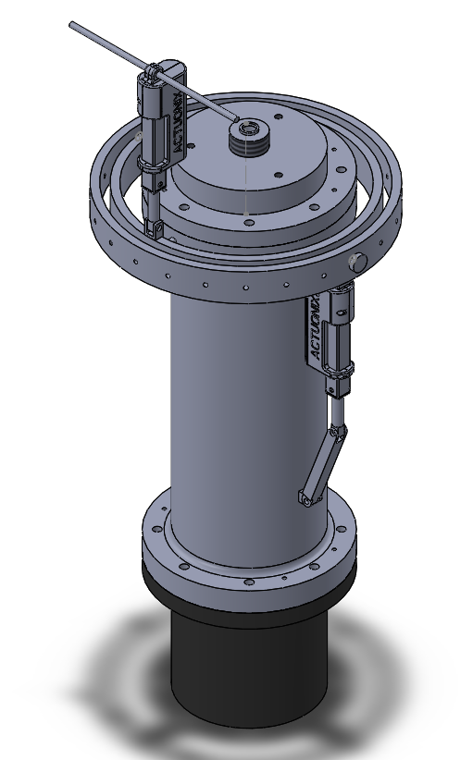

Gimbal System
Being able to control flight path of the rocket.
Controlled by two actuators.
Eventually get rid of rocket body fins to cut down weight of the rocket.
University of New Hampshire
Students for the Exploration and Development of Space

Slide 8
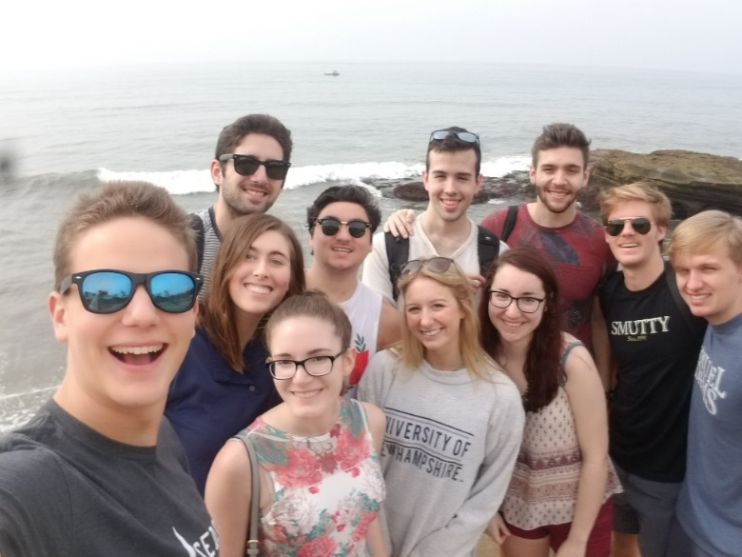
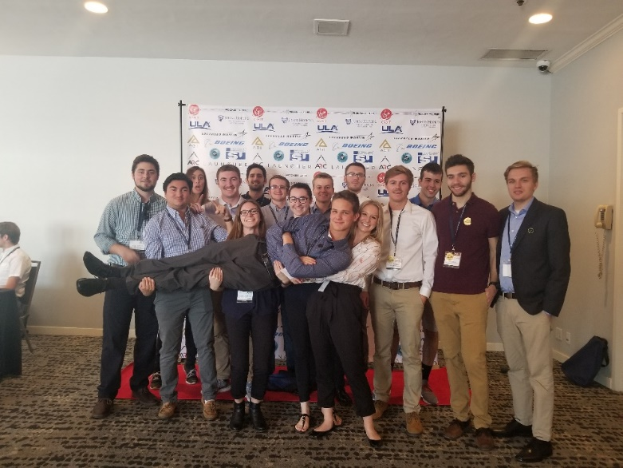
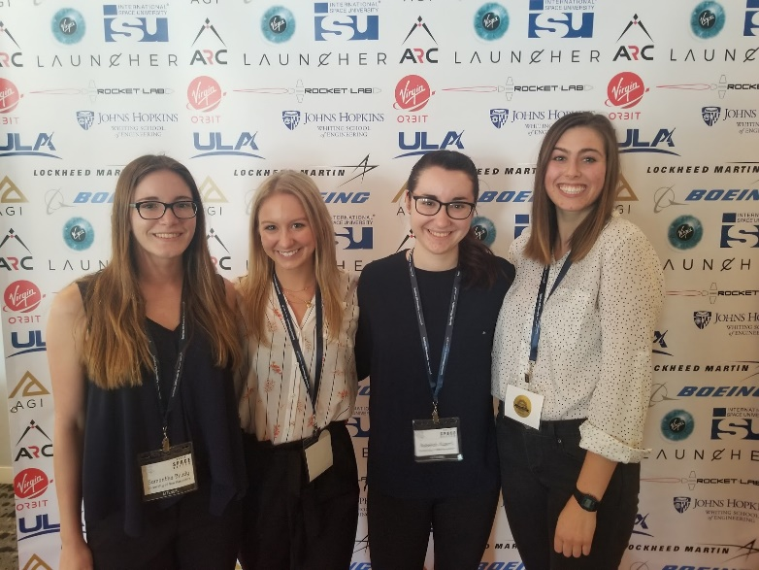
SpaceVision
SEDS USA hosts a national conference every year called ‘SpaceVision’ where many of the various SEDS chapters congregate to network and listen to speakers. This year, it will be on November 2019 in Arizona State University. We brought 16 of our members to take part in the 2018 SpaceVision located in San Diego California.
University of New Hampshire
Students for the Exploration and Development of Space
Notes:
EE major too

Slide 9
Future Obstacles/ Challenges
Completion of our hybrid rocket engine
Complete integration of all electronic / avionic parts into a rocket
Gimbal System / Thrust vectoring
Safety!
University of New Hampshire
Students for the Exploration and Development of Space

Slide 10
Questions?
University of New Hampshire
Students for the Exploration and Development of Space

Slide 11

Interested SEDS as your senior project?
Stop by Kings S172
Or
E-mail Thomas Collins at twc1001@wildcats.unh.edu
Name
Why are you interested in joining SEDS?
Contact ASAP – already started
University of New Hampshire
Students for the Exploration and Development of Space

